Slide 1
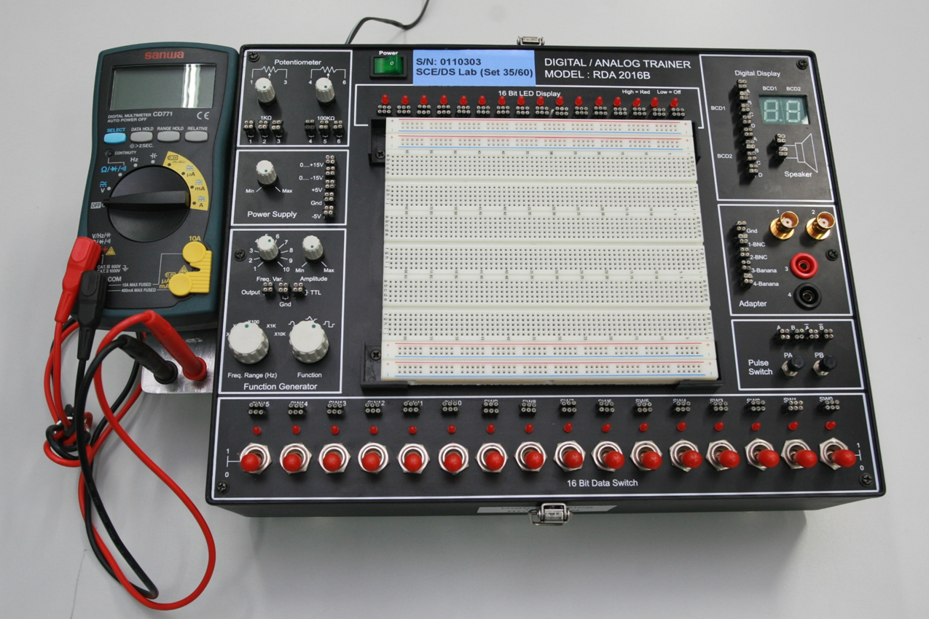
Introduction on Digital\Analog (DA) Trainer Set
16 bit LED Display
Power “on/off” Switch
1kohm and 100kohm potentiometer
The Digital Display
The Power Supply
The Breadboard
Adapter
The Function Generator
Pulse switch
16 bit Data Swtich

Slide 2
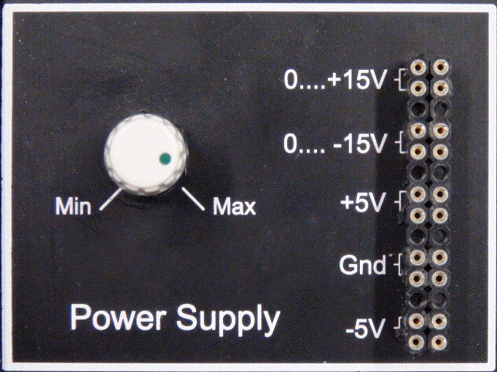
Introduction on the Power Supply
The Power Supply provides a
(i) Fixed : +5V and -5V
(ii) Variable Voltages : 0 to +15V
and 0 to -15V.
(iii) Ground point
Turn knob C to vary the voltage from 0 to ±15V.
C
C
Four turn-pins are internally connected
Four turn-pins are internally connected

Slide 3
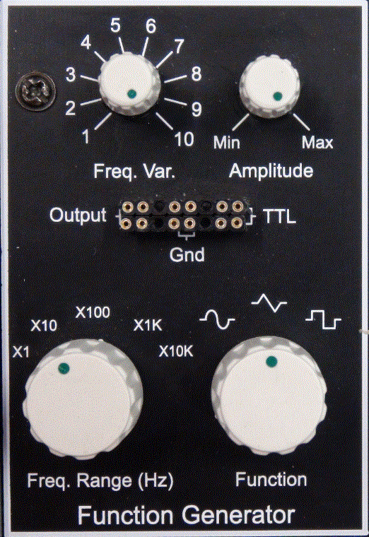
Introduction on the Function Generator
The Output waveform is determined by adjusting the Function knob D and the amplitude can be increase and decrease by adjusting the Amplitude knob G.
The TTL and Output frequency can be
adjusted by setting the Freq.Range
knob E and adjusting the Freq. Var.
(fine) knob F.
The Function Generator provides
(i) Fixed TTL : +2.8V to +5V
(ii) Ground point and
(iii) Output waveform
F
F
G
G
Four turn-pins are internally connected
Four turn-pins are internally connected
E
E
D
D
Frequency Range
X1 : 1Hz ~ 10Hz
X10 : 10Hz ~ 100Hz
X100 : 100Hz ~ 1Khz
X1K : 1Khz ~ 10Khz
X10K : 10Khz ~ 100Khz

Slide 4
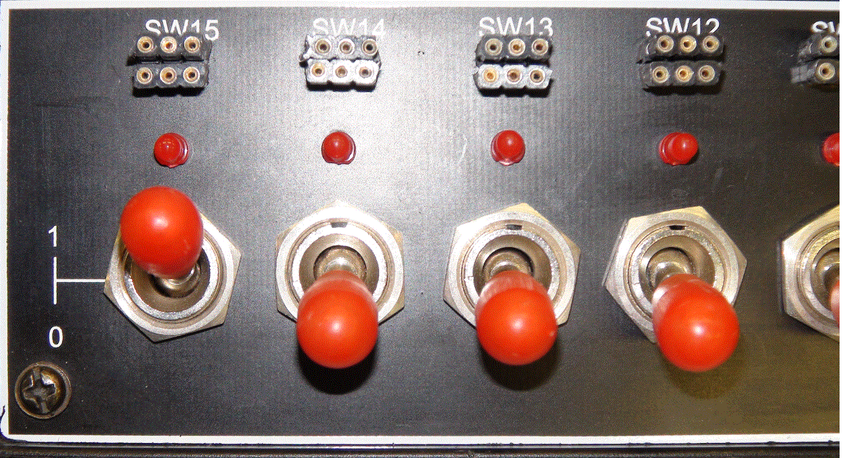
Introduction on the 16 Bit Data Switch
2. When the switch is set to 1
position , the output is at HI LEVEL
and the LED will turn on.
There are 16 set of Data/Toggle Switches. When the switch is set to 0
position , the output is at LO LEVEL
and the LED will turn off.
LED turn ON
LED turn OFF

Slide 5
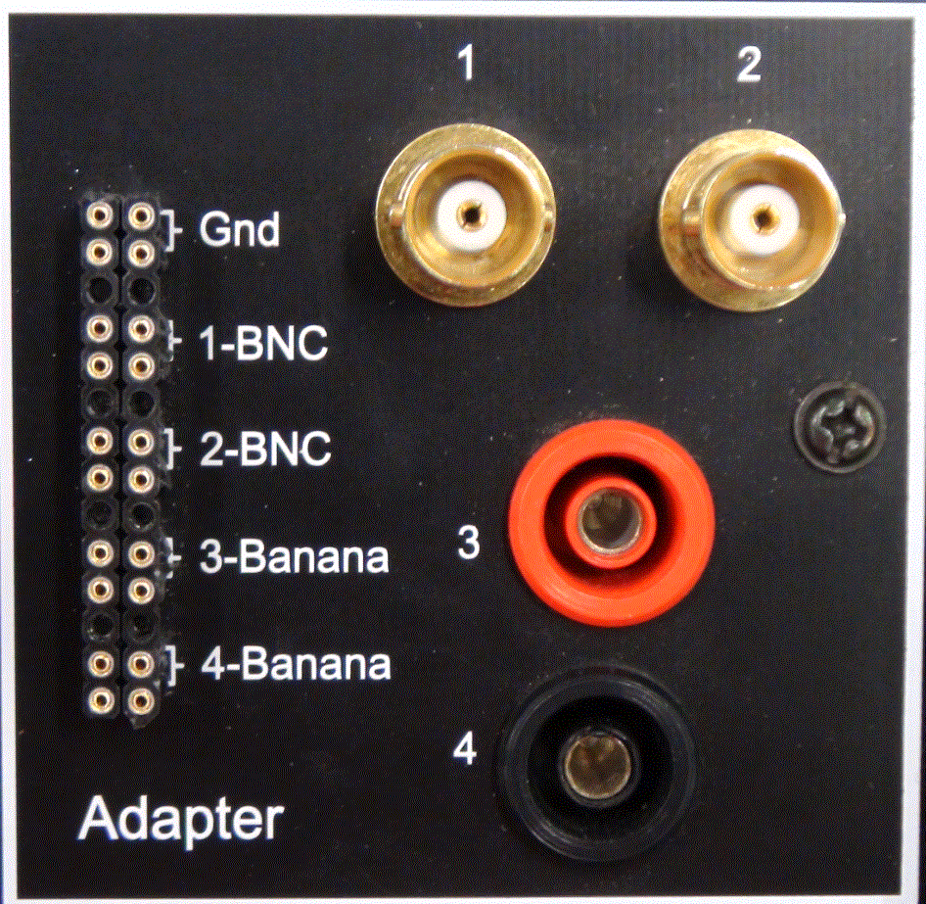
Introduction on the Adapter
BNC cable connected to CH1 of oscilloscope
BNC cable connected to CH2 of oscilloscope
The Adapter provides :-
(i) Ground point
1-BNC , connected to CH1 of the
oscilloscope.
2-BNC , connected to CH2 of the
oscilloscope.
Signal input from TTL/IC chip
Signal input from IC chip

Slide 6
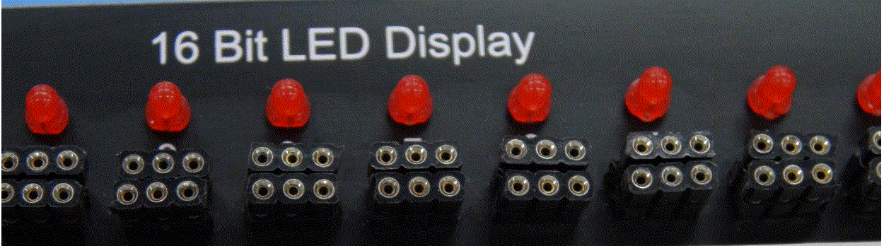
Introduction on the 16 Bit LED Display
LED off = LO LEVEL
LED on = HI LEVEL
Six turn-pins are internally connected
The are 16 Bit LED Display.
When at HI LEVEL the LED will turn on.
It will turn off when at LO LEVEL.

